Slide 1
Processes
Yubin Xia
IPADS, SJTU
ACKs: Some slides are adapted from the textbook’s original slides and Frans’s OS course notes

Slide 2
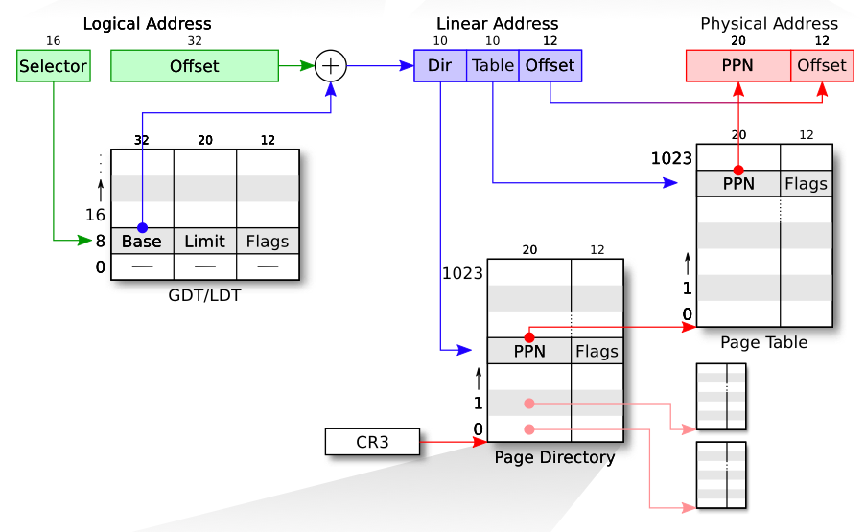
Review: LA->LA->PA

Slide 3
Review
Booting: enabling segment and paging
Segment: set GDT & use long jmp (ljmp)
Paging: temporary page table (entrypgdir) with kernel mapped at both 0x80100000 and 0x100000
Different page size: 4KB vs. 4MB(2MB)

Slide 4
Process in xv6

Slide 5
Processes Outline
Process Concept
Process Scheduling
Operations on Processes
Interprocess Communication
Examples of IPC Systems
Communication in Client-Server Systems

Slide 6
Process: Big Picture
More programs than processors
How to share the limited number of processors among the programs?
Observation: most programs do not need the processor continuously
because they frequently have to wait for input (from user, disk, network, etc.)
Idea: when one program must wait, it releases the processor, and gives it to another program

Slide 7
Threads
Mechanism: thread of computation, an active computation.
A thread is an abstraction that contains
the minimal state that is necessary to stop an active and resume it at some point later
The state depends on the processor
On x86, it is the processor registers

Slide 8
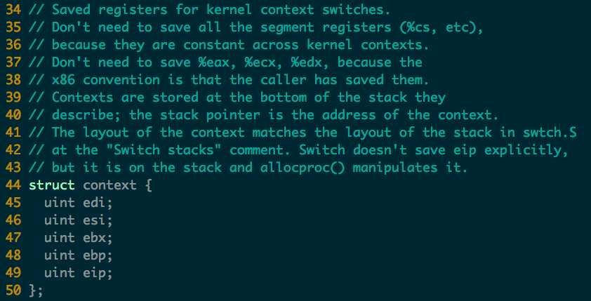
Threads in xv6

Slide 9
Address spaces and threads
Address spaces and threads are in principle independent concepts
One can switch from one thread to another thread in the same address space
or one can switch from one thread to another thread in another address space

Slide 10
Process Concepts
Process: a program in execution
one address space + one or more threads of computation
A process includes:
program counter, stack, data section
In xv6 all user programs contain one thread of computation and one address space
Q: How to support multi-threading in a process?

Slide 11
Process State
As a process executes, it changes state
new: The process is being created
running: Instructions are being executed
waiting: The process is waiting for some event to occur
ready: The process is waiting to be assigned to a processor
terminated: The process has finished execution
In xv6
Notes:
Embryo: 萌芽, 初期

Slide 12
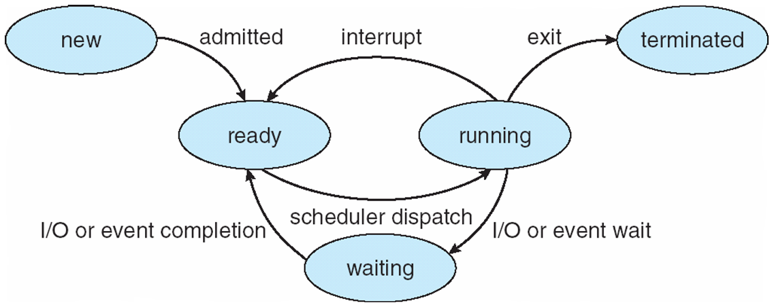
Diagram of Process State

Slide 13
Process Control Block (PCB)
Information associated with each process
Process state
Program counter
CPU registers
CPU scheduling information
Memory-management information
Accounting information
I/O status information

Slide 14
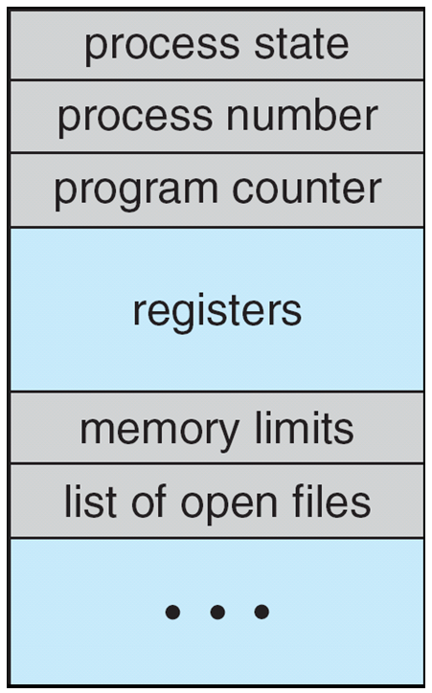
Process Control Block (PCB)

Slide 15
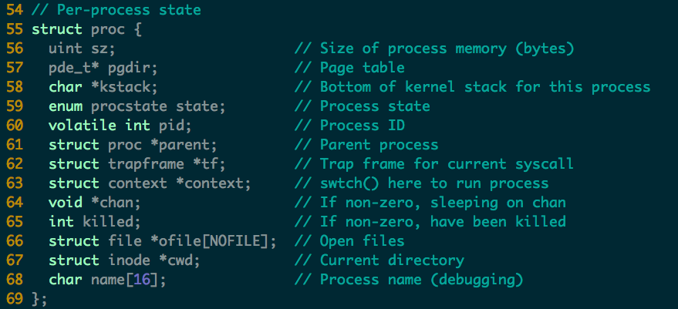
Process in xv6 (proc.c)

Slide 16
Context Switch
When CPU switches to another process, the system must do it via a context switch
save the state of the old process
load the saved state for the new process Context of a process represented in the PCB
Context-switch time is overhead
the system does no useful work while switching
Time dependent on hardware support

Slide 17
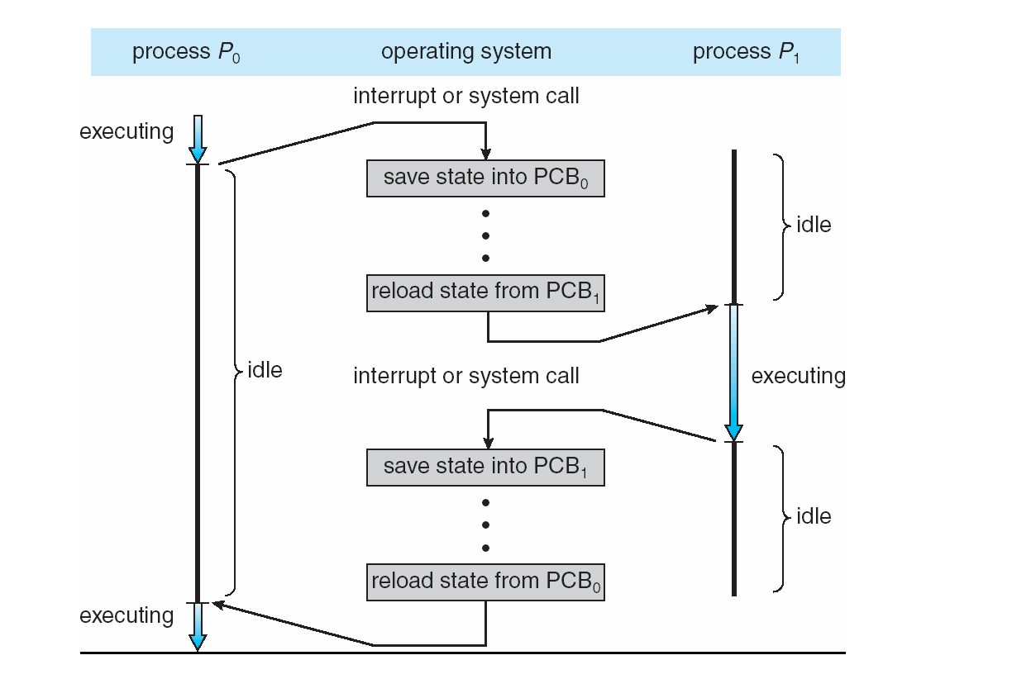
CPU Switch From Process to Process

Slide 18
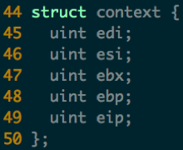
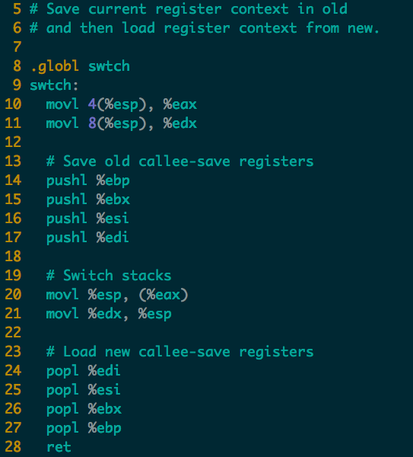

Context Switch in xv6 (swtch.S)
push
pop
new
new
old
old
ret addr
ret addr
ebp
ebp
ebx
ebx
esi
esi
edi
edi
esp
esp
Notes:
Note that the 4 pushl will generate a struct context. One missing field is eip, where is it?
Where is the old context saved?

Slide 19
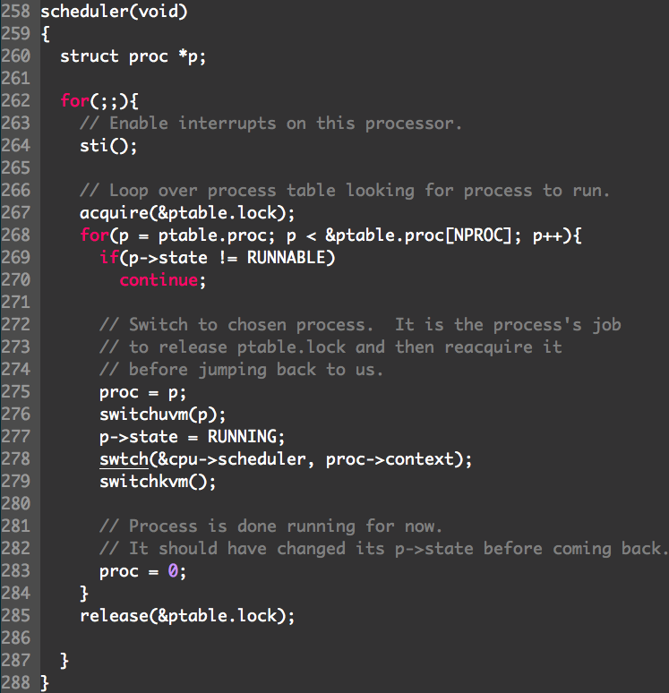
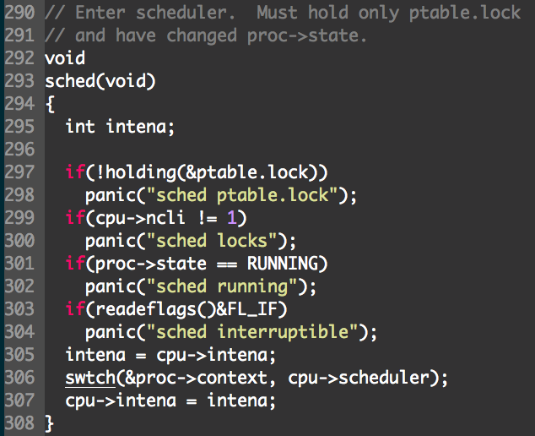
User space
User -> kernel -> user
Notes:
sched => switch to Scheduler => switchkvm (to kernel) => switchuvm (to user) => switch to P => sched

Slide 20
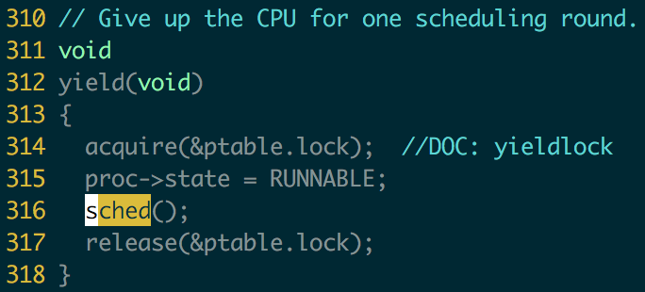
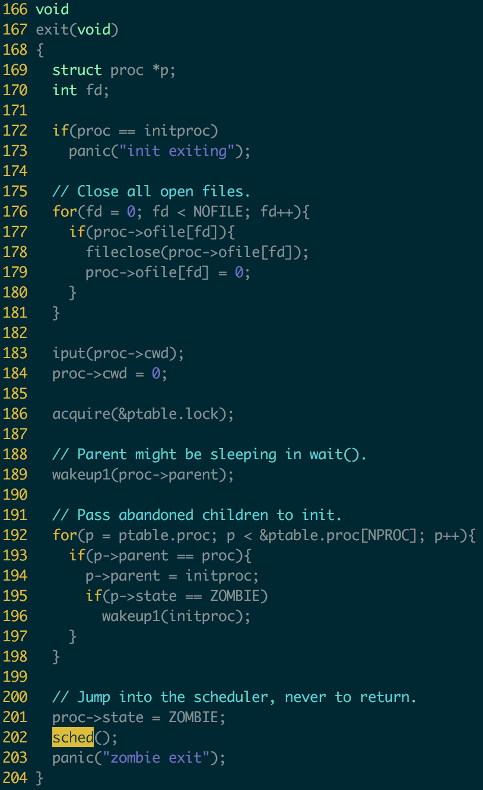
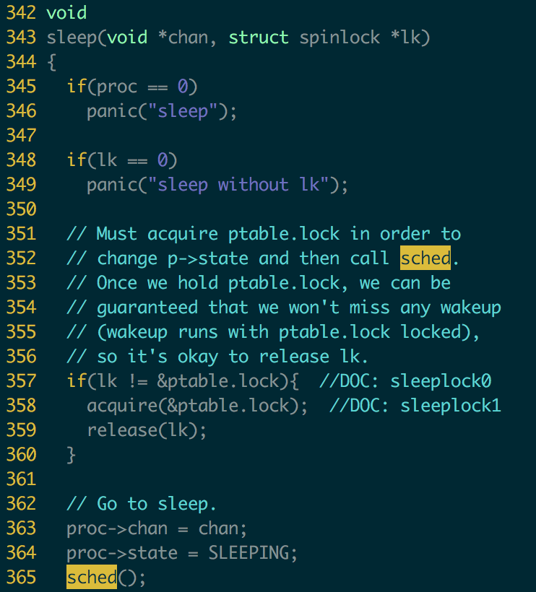

Slide 21
Process Scheduling Queues
Job queue – set of all processes in the system
Ready queue – set of all processes residing in main memory, ready and waiting to execute
Device queues – set of processes waiting for an I/O device
Processes migrate among the various queues

Slide 22
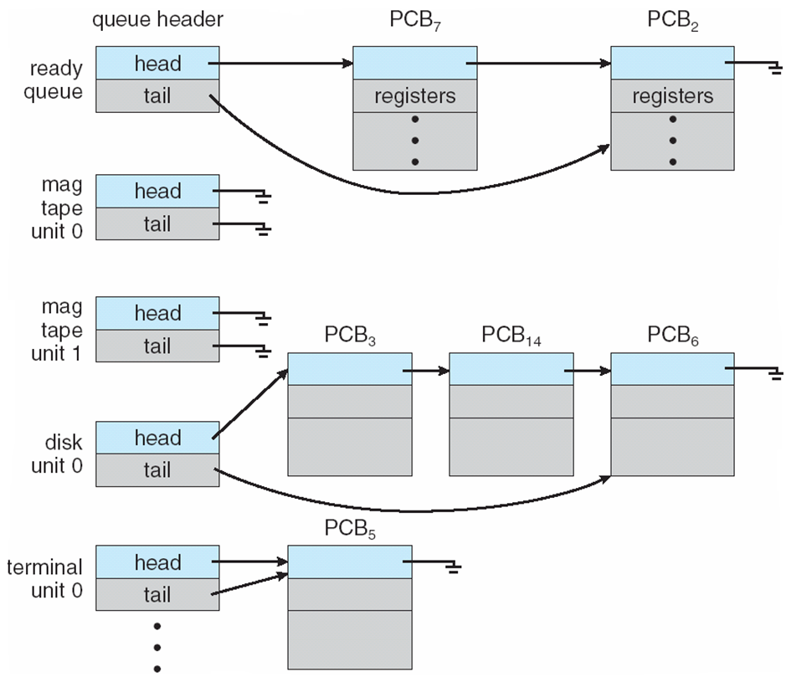
Ready Queue & Various I/O Device Queues

Slide 23
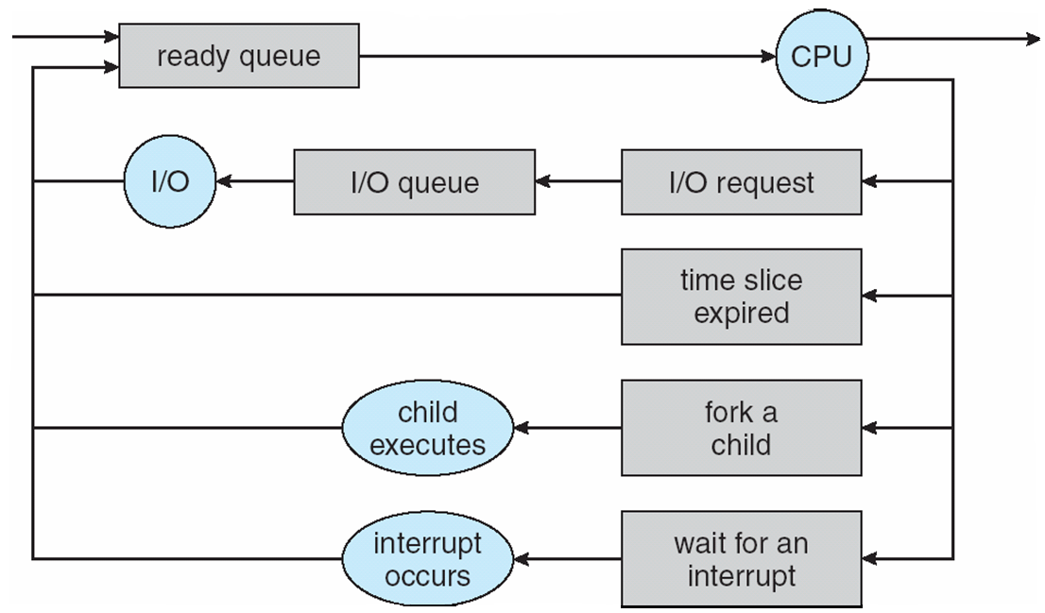
Representation of Process Scheduling

Slide 24
Schedulers
Long-term scheduler (or job scheduler) – selects which processes should be brought into the ready queue
Short-term scheduler (or CPU scheduler) – selects which process should be executed next and allocates CPU

Slide 25
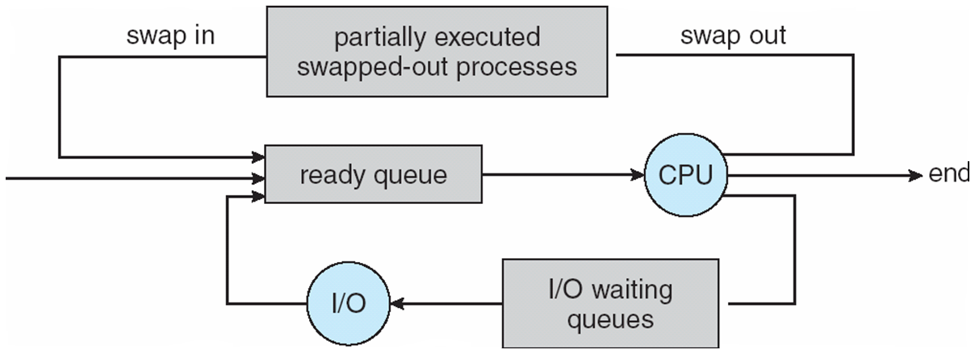
Addition of Medium Term Scheduling

Slide 26
Schedulers (Cont)
Short-term scheduler is invoked very frequently (milliseconds) ⇒ (must be fast)
Long-term scheduler is invoked very infrequently (seconds, minutes) ⇒ (may be slow)
The long-term scheduler controls the degree of multiprogramming

Slide 27
Scheduler (cont.)
Processes can be described as either:
I/O-bound process – spends more time doing I/O than computations, many short CPU bursts
CPU-bound process – spends more time doing computations; few very long CPU bursts

Slide 28
Process Creation
Parent process create children processes
forming a tree of processes
Generally, process identified and managed via a process identifier (pid)
Resource sharing policies
share all resources
share subset of parent’s resources
share no resources

Slide 29
Process Creation (Cont)
Execution
Parent and children execute concurrently
Parent waits until children terminate
Address space
Child duplicate of parent’s
Child has a program loaded into it
UNIX examples
fork system call creates new process
exec system call used after a fork to replace the process’ memory space with a new program

Slide 30
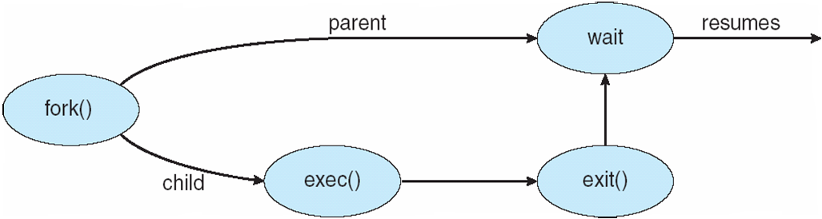
Process Creation

Slide 31
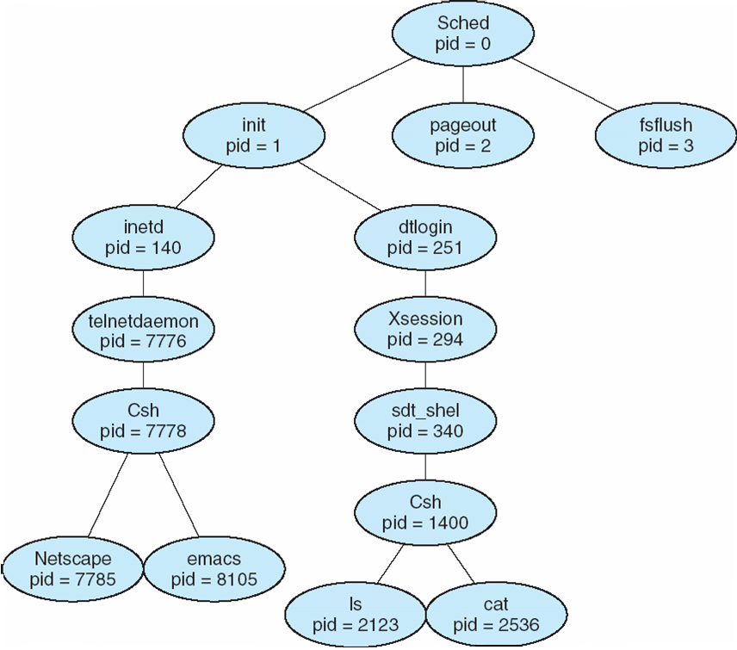
A tree of processes on a typical Solaris

Slide 32
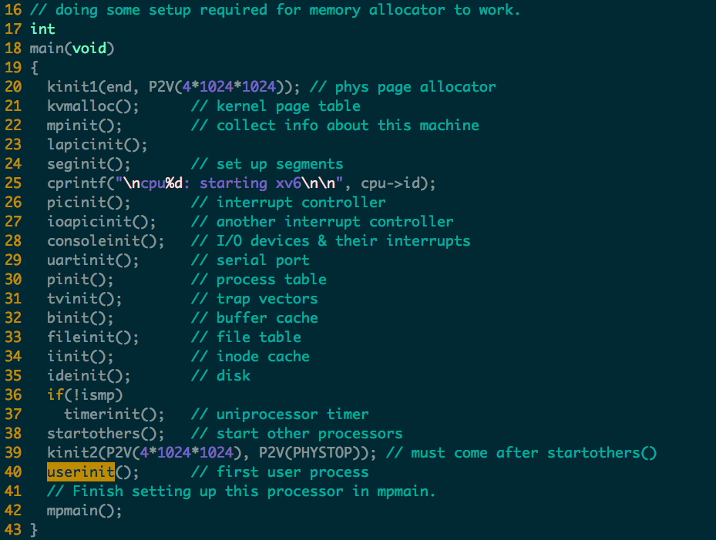

Slide 33
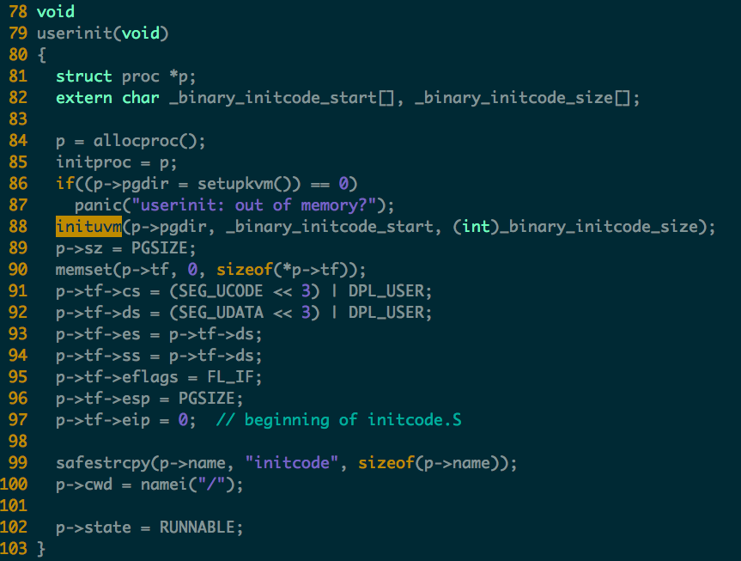
as part of the kernel build process, the linker embeds that binary that defines two special symbols, indicating the location and size of the binary.
Check the Makefile:
$(LD) $(LDFLAGS) -T kernel.ld -o kernel entry.o $(OBJS) -b binary initcode entryother

Slide 34
User VM mapping
Create a process
Inituvm : initialized user VM
Loaduvm: load program segment
Context switch
switchuvm
Grow/shrink/free VM
allocuvm
deallocuvm
Freeuvm
Fork
copyuvm

Slide 35
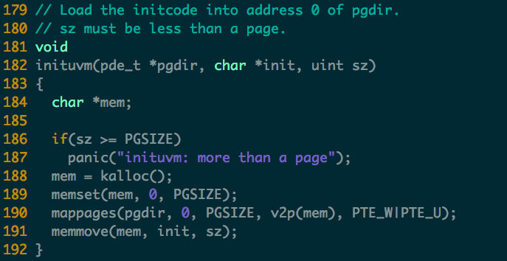

Slide 36
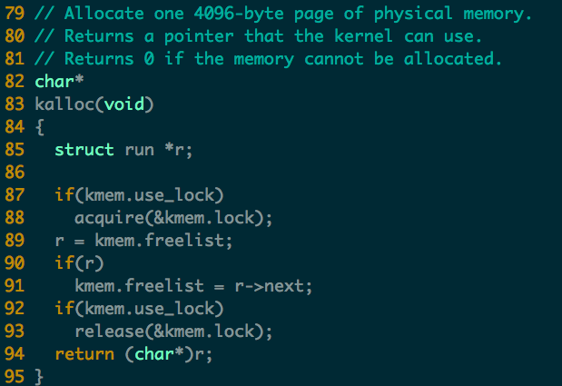

Slide 37
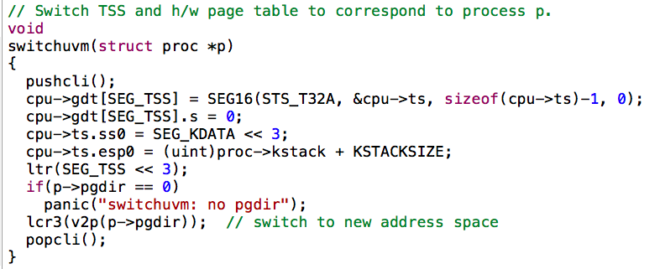

Slide 38
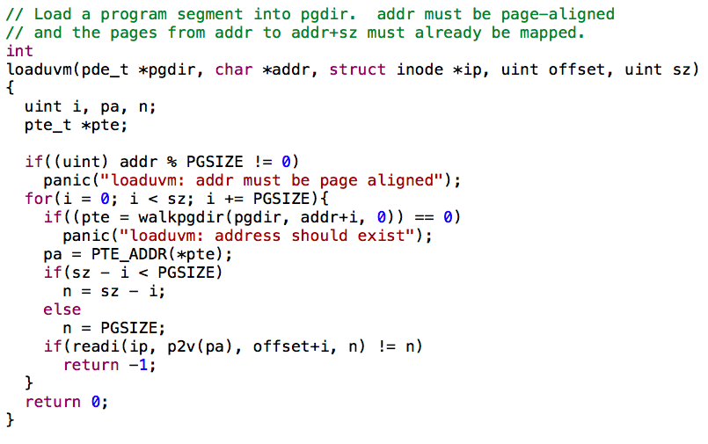

Slide 39
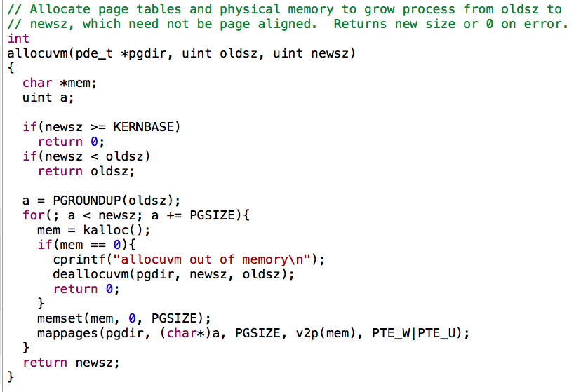

Slide 40
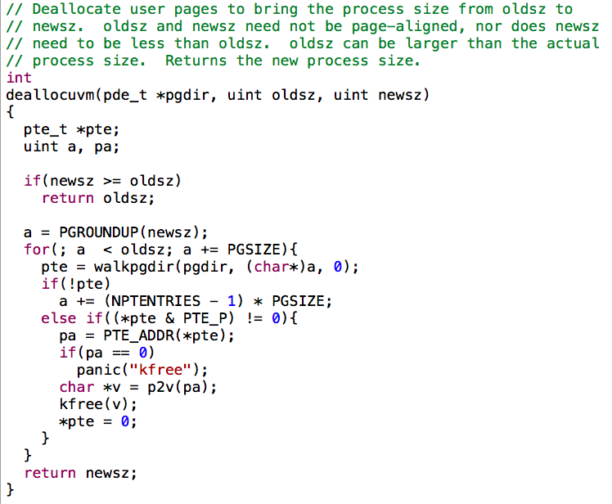

Slide 41
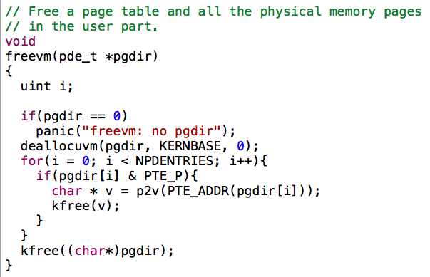

Slide 42
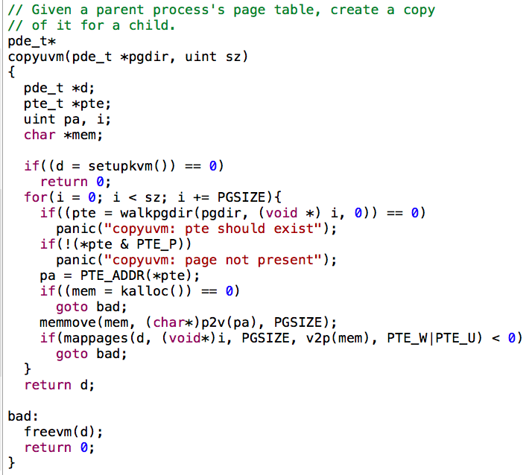

Slide 43
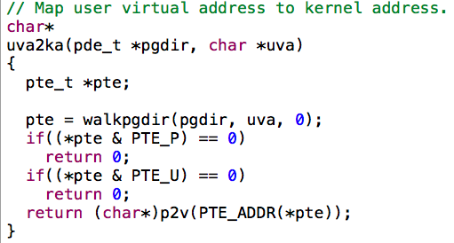

Slide 44
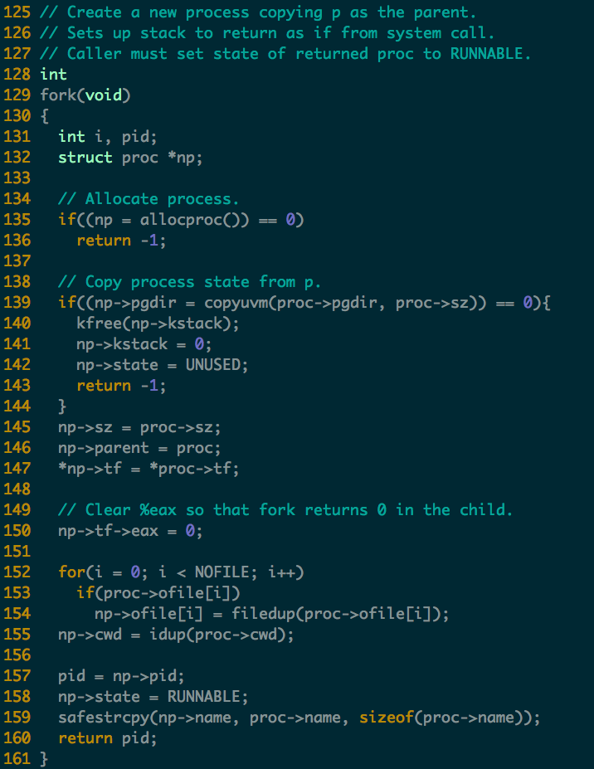
Process Creation in xv6
Read following code
allocproc()

Slide 45
Process Termination
Process executes last statement and asks the operating system to delete it (exit)
Output data from child to parent (via wait)
Process’ resources are deallocated by operating system
Parent may terminate execution of children processes (abort)
Child has exceeded allocated resources
Task assigned to child is no longer required

Slide 46
Process Termination (Cont.)
If parent is exiting
Some operating system do not allow child to continue if its parent terminates
All children terminated - cascading termination

Slide 47
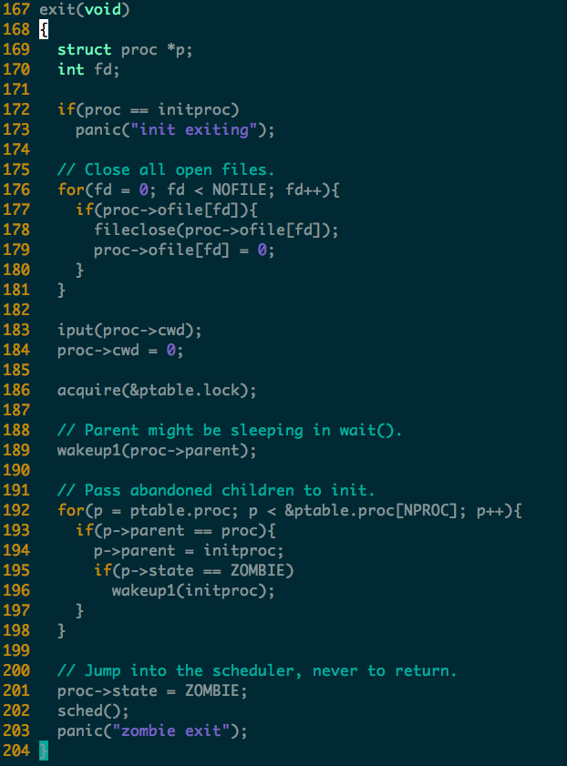

Slide 48
Homework
In xv6, one process contains only one thread. If we allow one process contains multiple threads, which state of the original PCB (process control block) should be per-thread and which should be per-process?

